Slide 1
Chapter 2 Basic Structures
Section 4
Sequences & Summations

Slide 2
Outline
Sequences
Summations

Slide 3
Sequences
Remark
  Ordered list of elements
    1, 2, 3, 5, 8 is a sequence with 5 elements
    1, 3, 9, 27, 81, …, 30, …, is an infinite sequence
Definition
  A Sequence (序列) {a_{n}} is a function from a subset of the set of integers (usually either the set of {0, 1, 2, …} or the set {1, 2, 3, …}) to a set S
  Use a_{n} to denote the image of the integer n
  Call a_{n} a term (项) of the sequence

Slide 4
Sequences
Example
  {a_{n}} where a_{n}=1/n
    1, 2, 3, 4, … or 1, 2, 3, 4, …
    ↓ ↓ ↓ ↓ … ↓ ↓ ↓ ↓ …
    1, ½, 1/3, ¼,… a₁, a₂, a₃, a₄, …
Example
  {a_{n}} where a_{n} is a rational number
    Every positive rational number is p/q
    First consider p+q=2, then p+q=3, p+q=4, …
    The sequence as 1, ½, 2/1,3/1,1/3,¼, 2/3, 3/2,4/1, 5/1,…
    Discussed in section 2.5

Slide 5
Geometric progression
Definition
  A Geometric progression (等比级数/几何级数) is a sequence of the form
  a, ar, ar², ar³,…, ar^{n}
  where the initial term a and common ratio r are real numbers
  Can be written as f(x)=a∙r^{x} , x∈N

Slide 6
Geometric progression
Example
  The sequences {b_{n}} with b_{n}=(-1)^{n}, {c_{n}} with c_{n}=2⋅5^{n}, {d_{n}} with d_{n}=6⋅(1/3)^{n} are geometric progression
    b_{n} : 1, -1, 1, -1, 1, …
    c_{n}: 2, 10, 50, 250, 1250, …
    d_{n:} 6, 2, 2/3, 2/9, 2/27, …

Slide 7
Arithmetic progression
Definition
  A Arithmetic progression (等差级数/算术级数) is a sequence of the form
  a, a+d, a+2d, …, a+nd
  where the initial term a and the common difference d are real numbers
  Can be written as f(x)=a+dx, x∈N
Example
  the sequences {s_{n}} with s_{n}=-1+4n, {t_{n}} with t_{n}=7-3n are arithmetic progression
    {s_{n}}: -1, 3, 7, 11, …
    {t_{n}}: 7, 4, 1, 02, …

Slide 8
String
Definition
  Finite sequences of the form a₁, a₂, …, a_{n} are called strings (串) , denoted by a₁a₂…a_{n}
  Strings are often used in computer science.
    Example: Recall Computer Representation of Sets in section 2.2
  The length of the string S is the number of terms in this string
  The empty string, denoted by λ, is the string that has no terms

Slide 9
Recurrence relation
Definition
  A recurrence relation (递归关系/递推关系) for the sequence {a_{n}} is an equation that expresses a_{n} in terms of one or more of the previous terms of the sequence, namely, a₀, a₁, . . . , a_{n−1}, for all integers n with n ≥ n₀, where n₀ is a nonnegative integer. A sequence is called a solution of a recurrence relation if its terms satisfy the recurrence relation.
Example
  a_{n}=a_{n-1}+3 for n=1,2,3,… and a₁=2
    a₂ = a₁+3=2+3=5, a₃=a₂+3=(2+3)+3=2+3x2=8 ,
    a₄ = a₃+3=(2+3+3)+3=2+3+3+3=2+3x3=11
    a_{n} = 2+3(n-1)
  a_{n}= a_{n-1}+3= (a_{n-2}+3)+3= a_{n-2}+3x2= (a_{n-3}+3)+3x2= a_{n-3}+3x3
  = a₂+3(n-2)= (a₁+3)+3(n-2)= 2+3(n-1)

Slide 10
Recurrence relation
Fibonacci sequence
  f₀=0, f₁=1, f_{n}=f_{n-1}+f_{n-2}, for n=2, 3, 4
    f₂=f₁+f₀=1+0=1
    f₃=f₂+f₁=1+1=2
    f₄=f₃+f₂=2+1=3
    f₅=f₄+f₃=3+2=5
    f₆=f₅+f₄=5+3=8

Slide 11
Recurrence relation
Closed formula (解析式)
  We say that we have solved the recurrence relation together with the initial conditions when we find an explicit formula, called a closed formula, for the terms of the sequence.
Example
  Determine whether the sequence {a_{n}}, a_{n}=3n for every nonnegative integer n, is a solution of the recurrence relation a_{n}=2a_{n-1}-a_{n-2} for n=2,3,4, … . What about a_{n}=2^{n}?
  Solution:
  For n≥2, 2a_{n-1}-a_{n-2}=2(3(n-1))-3(n-2)=3n=a_{n}. Therefore a_{n}=3n is a solution of the recurrence relation.
  Suppose a_{n}=2^{n}, Note that a₀=1, a₁=2, a₂=4, but 2a₁-a₀=2x2-1=3 ≠a₂, thus a_{n}=2^{n} is not a required solution.

Slide 12
Special integer sequences
Remark
  Finding some patterns among the terms
  Are terms obtained from previous terms
    by adding the same amount or an amount depends on the position in the sequence?
    by multiplying a particular amount?
    by combining previous terms in a certain way?
    In some cycle?

Slide 13
Special integer sequences
Example
  Find formulate for the sequences with the following 5 terms
    1, ½, ¼, 1/8, 1/16
    1, 3, 5, 7, 9
    1, -1, 1, -1, 1
Example
  Find formulate for the sequences with the following terms
    The first 10 terms: 1, 2, 2, 3, 3, 3, 4, 4, 4, 4
    The first 10 terms: 5, 11, 17, 23, 29, 35, 41, 47, 53, 59

Slide 14
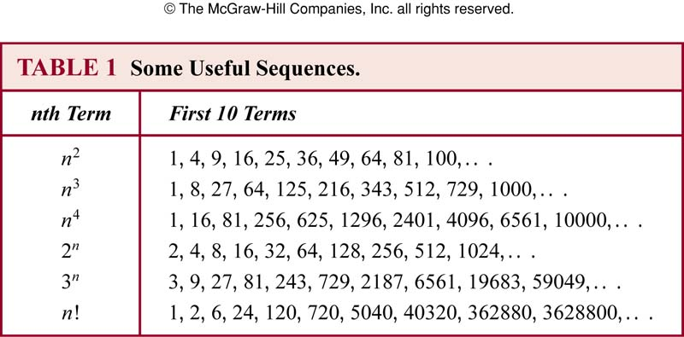
Special integer sequences
Example
  Conjecture a simple formula for {a_{n}} where the first 10 terms are 1, 7, 25, 79, 241, 727, 2185, 6559, 19681, 59047

Slide 15
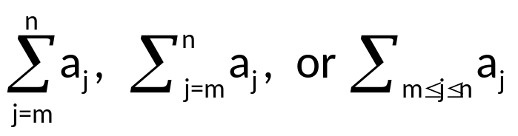
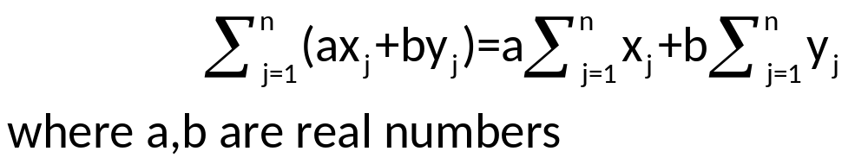
Summations
Remark
  The sum of terms, a_{m}, a_{m+1}, …, a_{n} from {a_{n}}, represented by summation notation
  that represents a_{m}+ a_{m+1}+ … + a_{n}
  Here j is the index of summation (can be replaced arbitrarily by i or k)
  The index runs from the lower limit m to upper limit n
  The usual laws for arithmetic applies

Slide 16
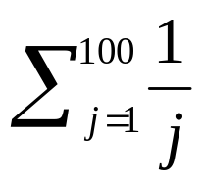
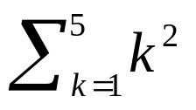
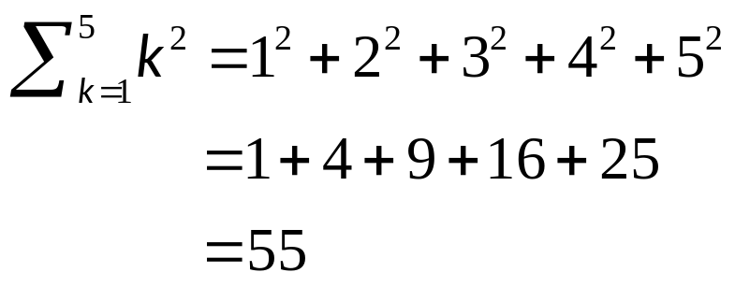
Summations
Example
  Express the sum of the first 100 terms of the sequence {a_{n}} where a_{n}=1/n, n=1, 2, 3, …
  Solution:
Example
  What is the value of
  Solution:

Slide 17
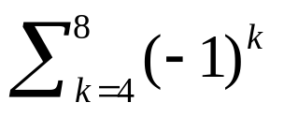
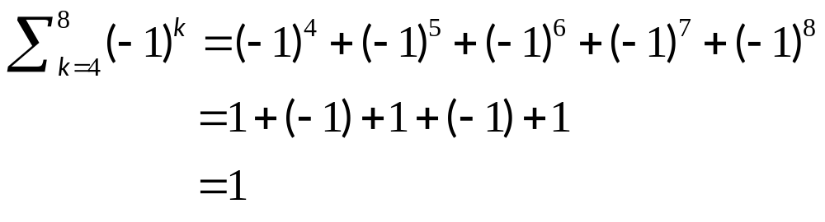
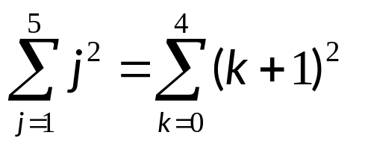
Summations
Example
  What is the value of
  Solution:
Example
  Shift index:
  By setting j=k+1, or k=j-1

Slide 18
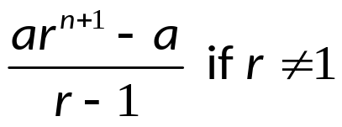
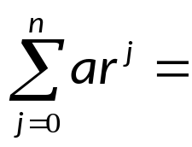

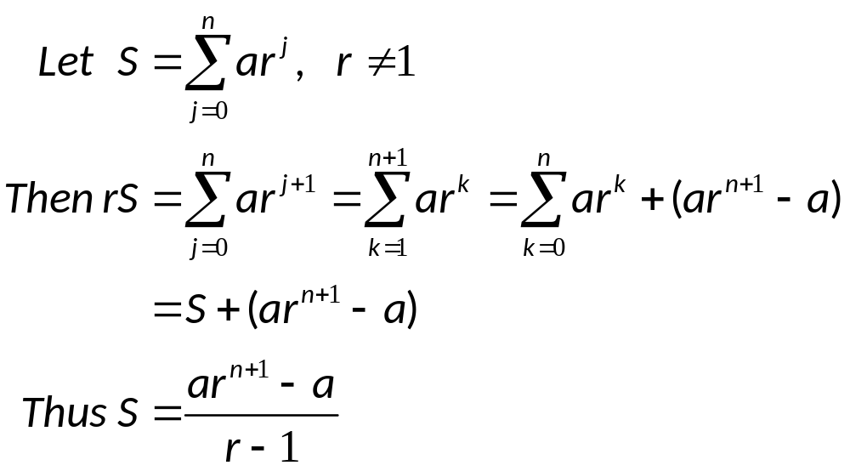
Geometric Series
Example
  Sums of geometric progressions
  Proof:

Slide 19
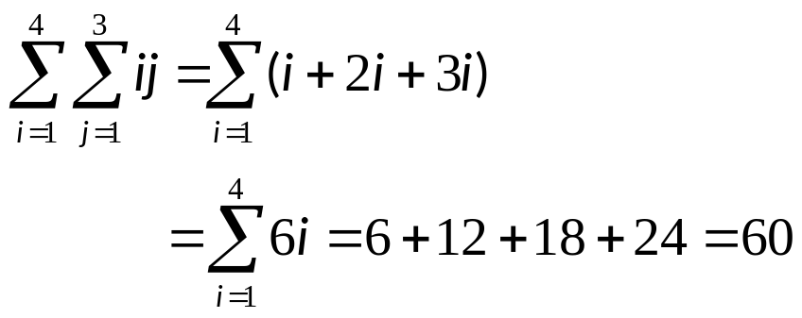
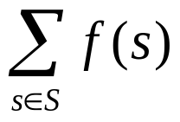
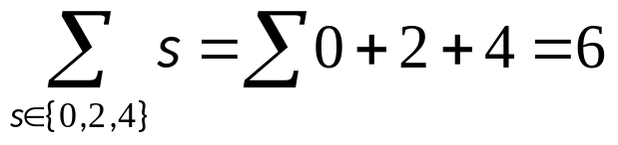
Double Summations
Remark
  Double summations often used in programs
    Example:
  *Can also write summation to add values of a function of a set
    Example:

Slide 20
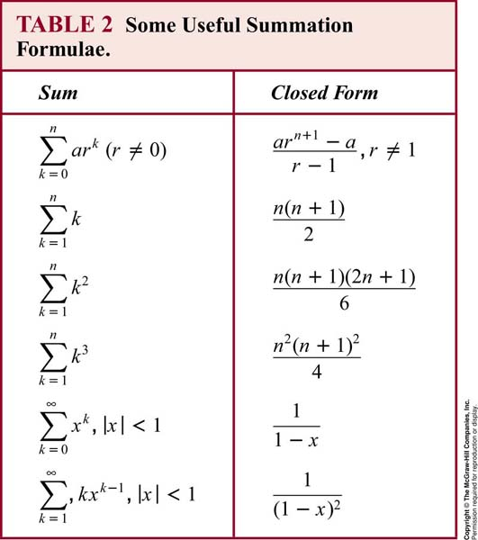
Double Summations

Slide 21
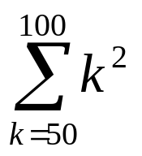
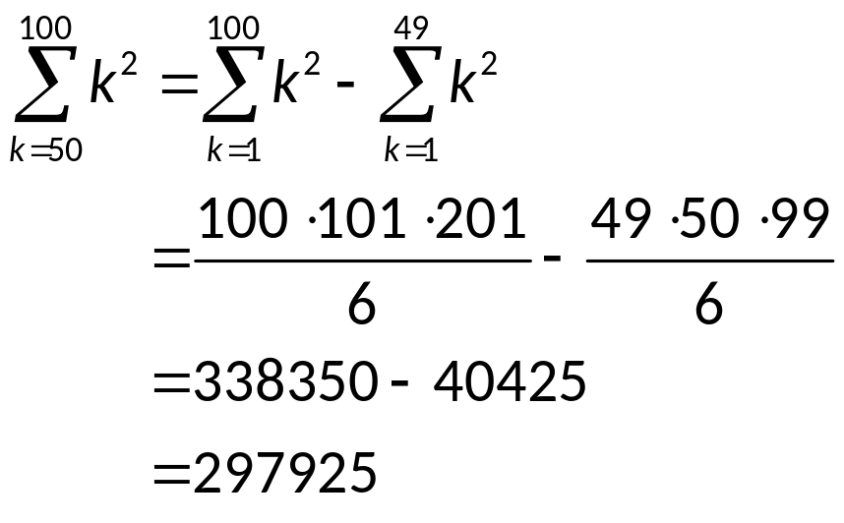
Examples
Example
  Find
  Solution:

Slide 22
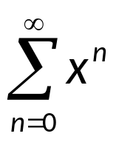
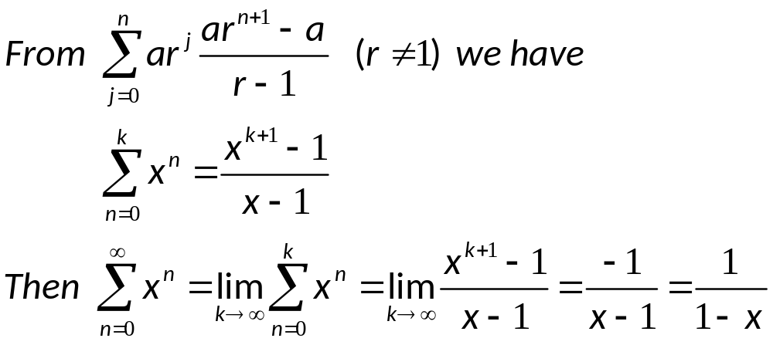
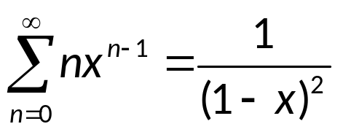
Examples
Example
  Let x be a real number with |x|<1, Find
  Solution:
Remark
  Differentiating both sides we have

Slide 23
Assignment
Exercises after 2.4: No.10(a,c,e,g), 16, 20 (Ver.6)
Exercises after 2.4: No.26(a,c,e,g), 32, 36 (Ver.7)

